Slide 1
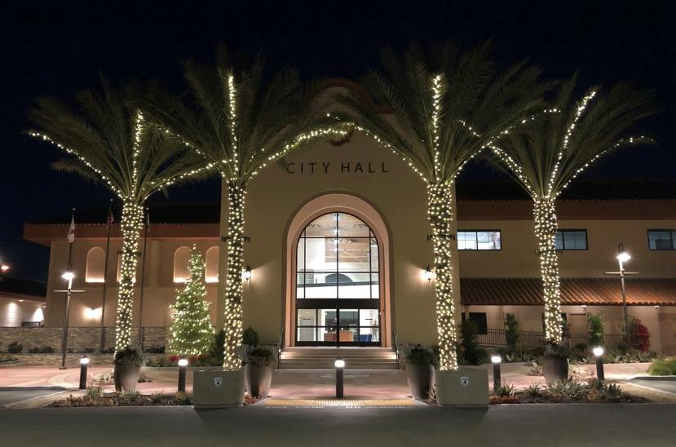

City Projects
What’s happening in la Habra?
3/28/2019

Slide 2
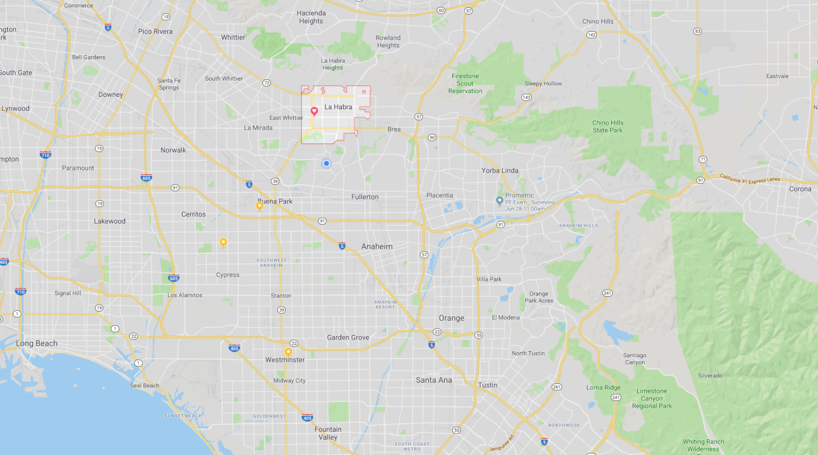
La Harrrrrrrrbra?

Slide 3
What’s happening in La Habra?
Bikeway Master Plan
Complete Streets Master Plan
Systemic Safety Analysis Report Program (SSARP)
Imperial Highway RTSSP
Traffic Management Center (TMC)
ITS Upgrades

Slide 4
What’s happening in La Habra?
Union Pacific Bike Trail (OC Loop)
Lambert Road (Repave)
Idaho Street (Repave)
Splash Pads
Future

Slide 5
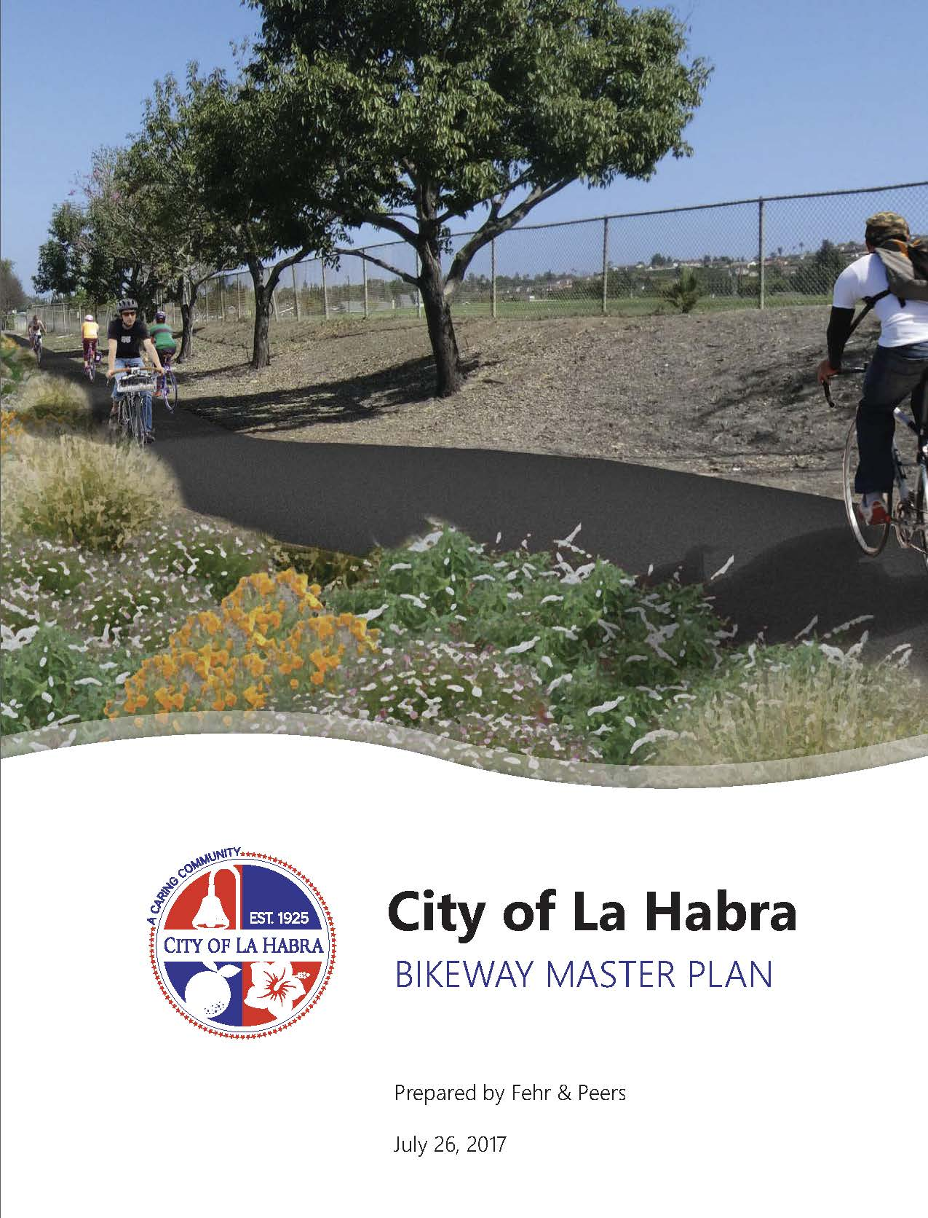
Bikeway Master Plan
Completed in 2017
Prioritized Bicycle Corridors
General Plan 2035
Class I – 1.1 mi (4.7 mi)
Class II – 2.5 mi (4.2 mi)
  Recently Added 5.5 mi
Class III – 14.4 mi (6.3 mi)

Slide 6
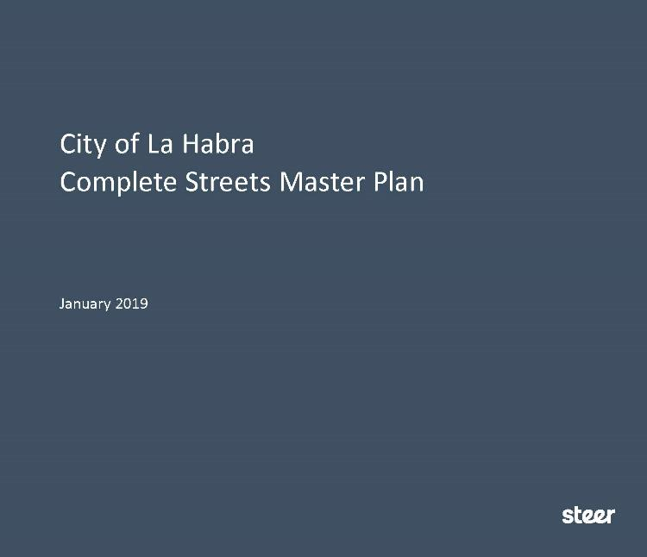
Complete Streets Master Plan
Completed in 2019
Active & Safe Streets
General Plan 2035
Complete Streets Act 2008
Improve Health
Improve Safety
Walkable Neighborhoods

Slide 7
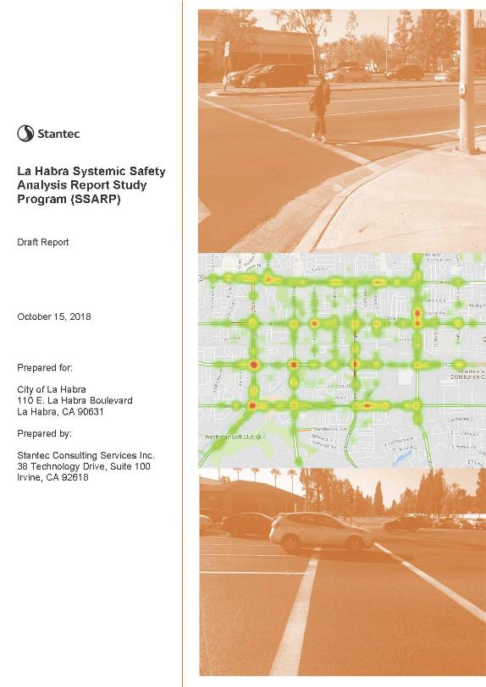
Systemic Safety Analysis Report Program (SSARP)
Currently On-Going (July 2019)
Awarded 2 HSIP Grants
Reduce Pedestrian Collisions
Primary Collision Factor (PCF):
  Unsafe Speed & Automobile right-of-way
Safety Countermeasures:
  Hardware Upgrades & Protected Turns

Slide 8
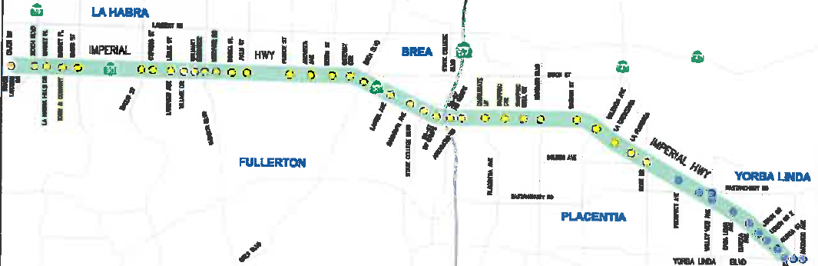
Imperial Highway RTSSP
Currently On-Going (May 2020)
La Habra, Fullerton, Brea, Placentia, Yorba Linda, and Caltrans
Reduce delay, GHG, and increase travel speeds
TMC, FO Communication, and CCTV Upgrades
46 signals (~10 mi)
$3.45 M

Slide 9
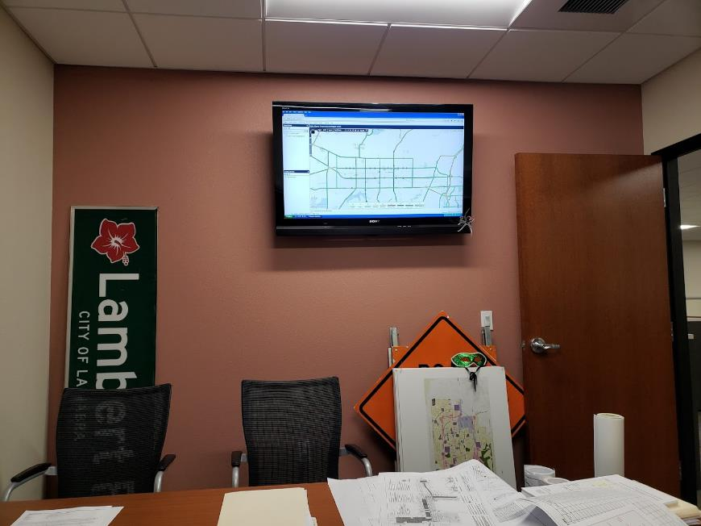
Traffic Management Center (TMC)
Currently On-Going (June 2019)
4 Screen Video Wall
Video Server
Clock Server
Soundbar
Field Laptop
SNMP Server/Client

Slide 10
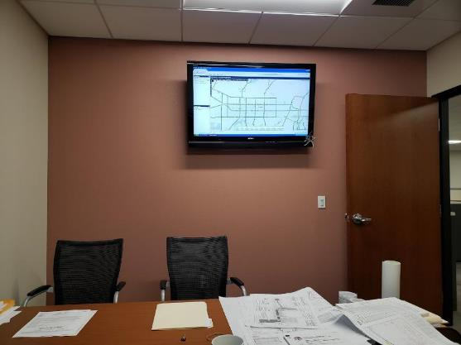




Traffic Management Center (TMC)
Currently On-Going (June 2019)
4 Screen Video Wall
Video Server
Clock Server
Soundbar
Field Laptop
SNMP Server/Client

Slide 11
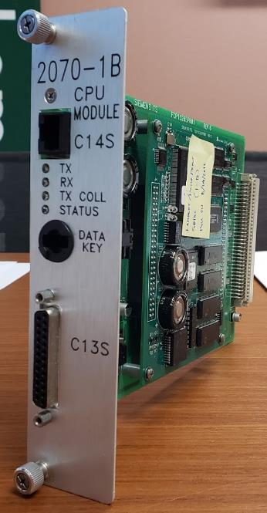
ITS Upgrades
2070 ATC Controllers (2070-1C Module - MaxTime)
  SPaT Compatible (Connected Vehicle)
MaxView ATMS
Moxa Switches (Edge & Hub)
332 Cabinets
Cohu Rise CCTV Cameras
Iteris Video Detection (Bike)

Slide 12
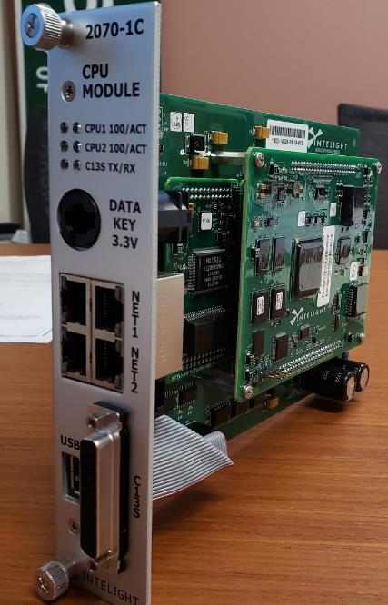
ITS Upgrades
2070 ATC Controllers (2070-1C Module - MaxTime)
  SPaT Compatible (Connected Vehicle)
MaxView ATMS
Moxa Switches (Edge & Hub)
332 Cabinets
Cohu Rise CCTV Cameras
Iteris Video Detection (Bike)

Slide 13
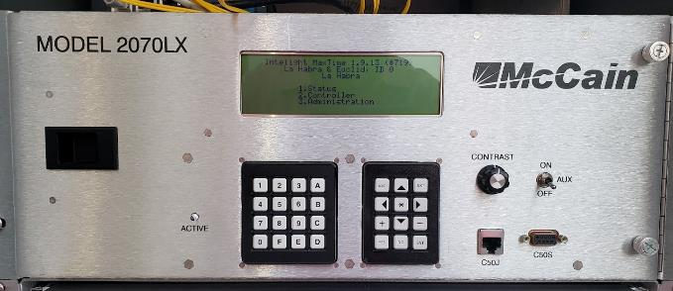
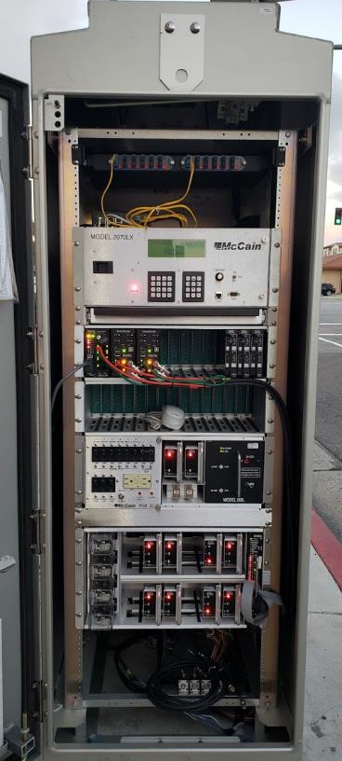
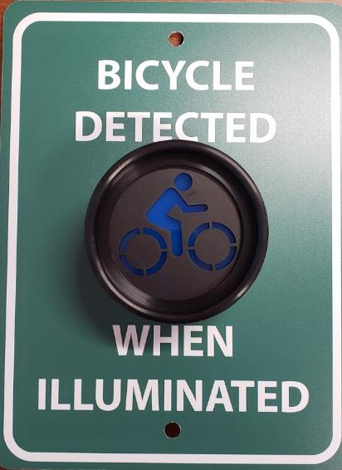
ITS Upgrades
2070 ATC Controllers (2070-1C Module - MaxTime)
  SPaT Compatible (Connected Vehicle)
MaxView ATMS
Moxa Switches (Edge & Hub)
332 Cabinets
Cohu Rise CCTV Cameras
Iteris Video Detection (Bike)

Slide 14
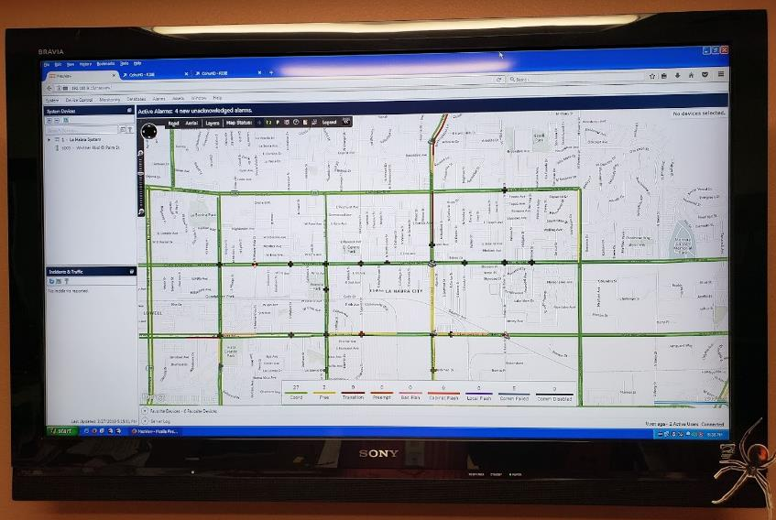
ITS Upgrades
2070 ATC Controllers (2070-1C Module - MaxTime)
  SPaT Compatible (Connected Vehicle)
MaxView ATMS
Moxa Switches (Edge & Hub)
332 Cabinets
Cohu Rise CCTV Cameras
Iteris Video Detection (Bike)

Slide 15
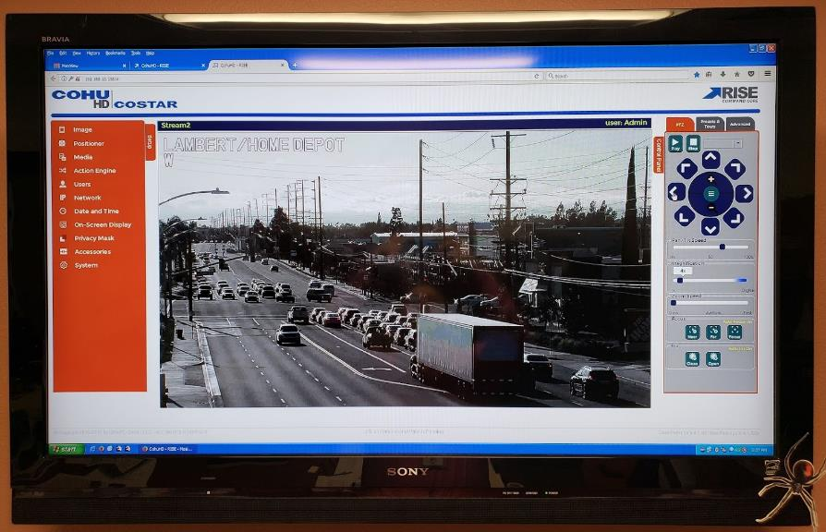
ITS Upgrades
2070 ATC Controllers (2070-1C Module - MaxTime)
  SPaT Compatible (Connected Vehicle)
MaxView ATMS
Moxa Switches (Edge & Hub)
332 Cabinets
Cohu Rise CCTV Cameras
Iteris Video Detection (Bike)

Slide 16
Union Pacific Bicycle Trail (OC Loop)
From this…

Slide 17
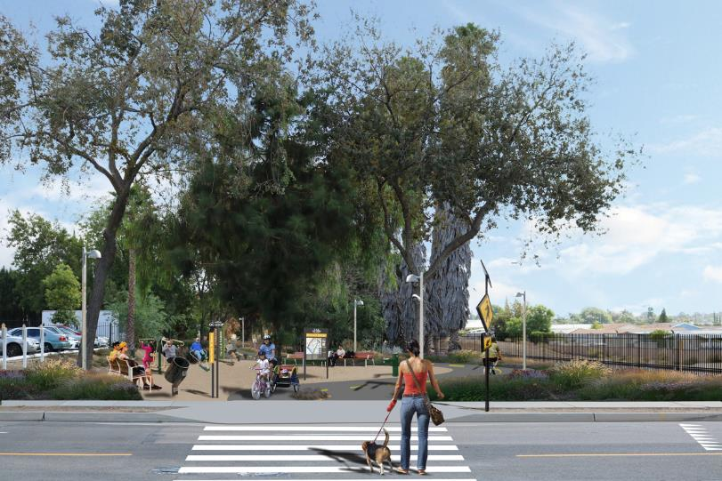
Union Pacific Bicycle Trail (OC Loop)
To this…

Slide 18
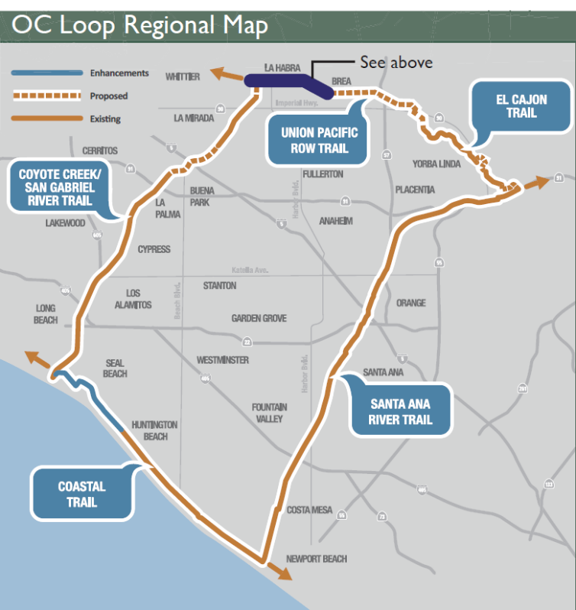
Union Pacific Bicycle Trail (OC Loop)
3.1 mi from west city limit to The Tracks at Brea
R/W acquisition from UPRR
  Northern 15’ of UPRR R/W
ATP Cycle 1, 2, 3A Grant Funding for R/W
  ~$3.1 M
OC Loop (66 mi) connection segment A

Slide 19
Lambert Road (Repave)
Completed in 2018
Worst Road in La Habra
Added Class II Bike Lanes (~5 mi)
Installed Wrong Way Signs
$5.6 M

Slide 20
Lambert Road (Repave)
Completed in 2018
Worst Road in La Habra
Added Class II Bike Lanes (~4.5 mi)
Installed Wrong Way Signs
$5.6 M

Slide 21
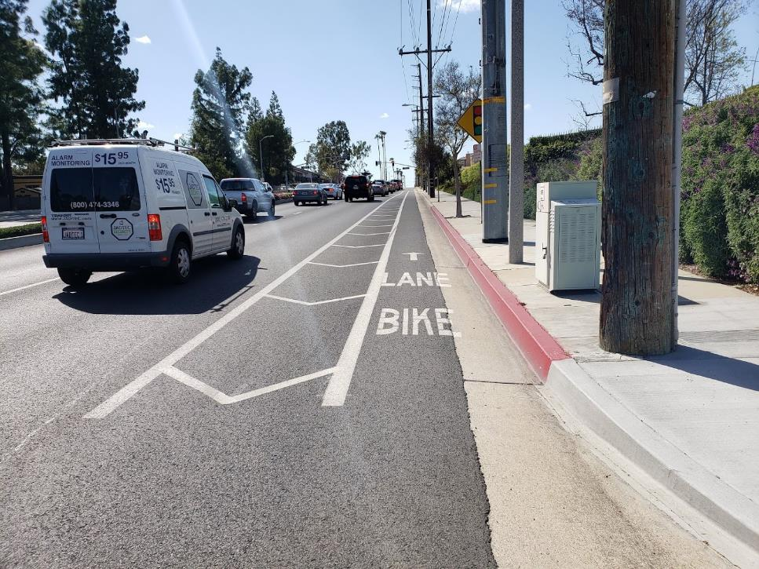
Lambert Road (Repave)
Completed in 2018
Worst Road in La Habra
Added Class II Bike Lanes (~4.5 mi)
Installed Wrong Way Signs
$5.6 M

Slide 22
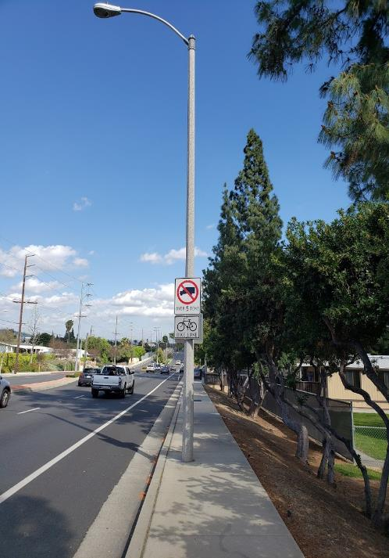
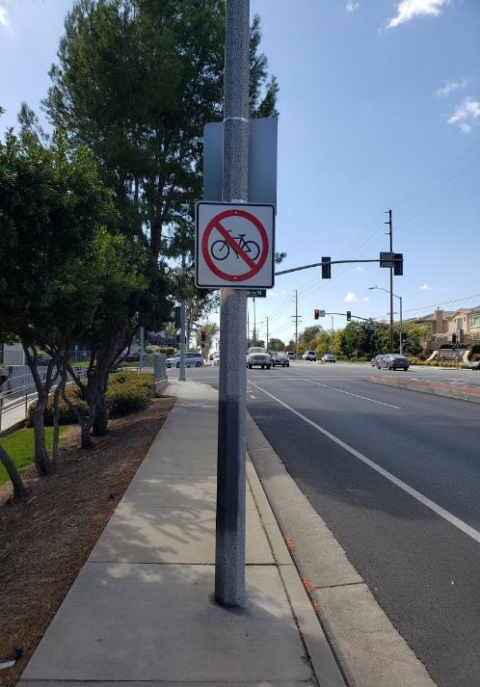
Lambert Road (Repave)
Completed in 2018
Worst Road in La Habra
Added Class II Bike Lanes (~4.5 mi)
Installed Wrong Way Signs
$5.6 M

Slide 23
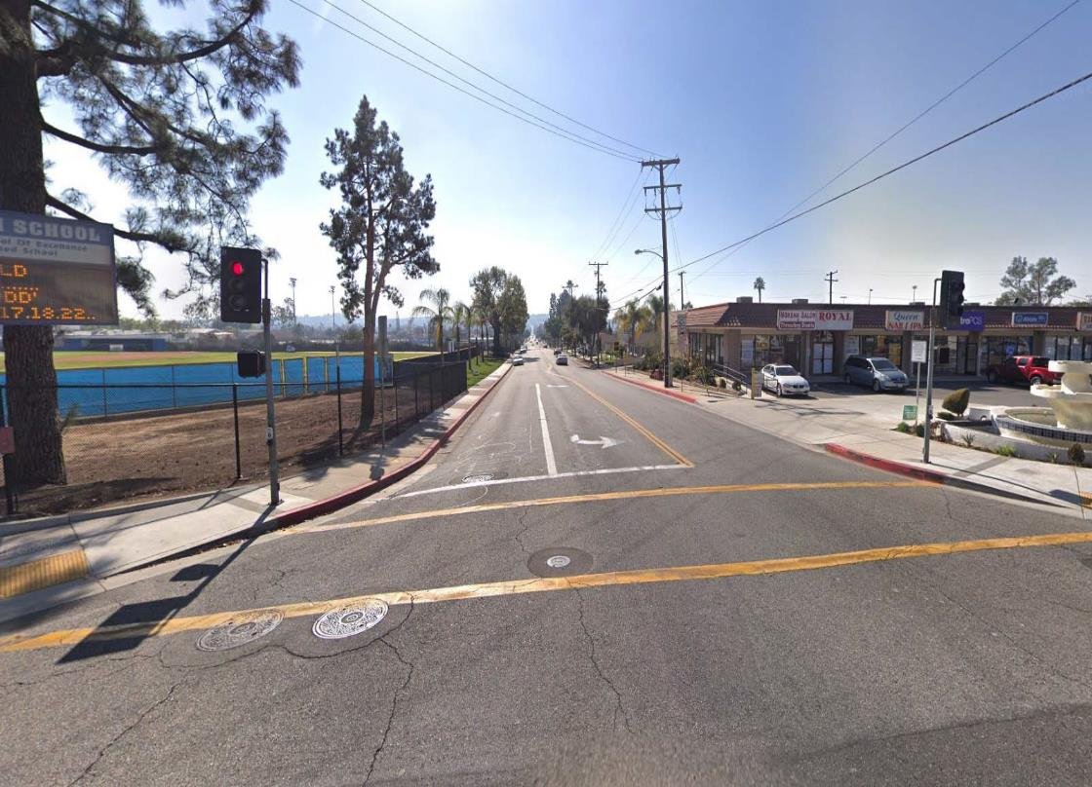
Idaho Street (Repave)
Completed in 2018
Added Class II Bike Lanes (~1 mi)
$800K
Reduced street crown from 12% to 7%
Replaced Water Main

Slide 24
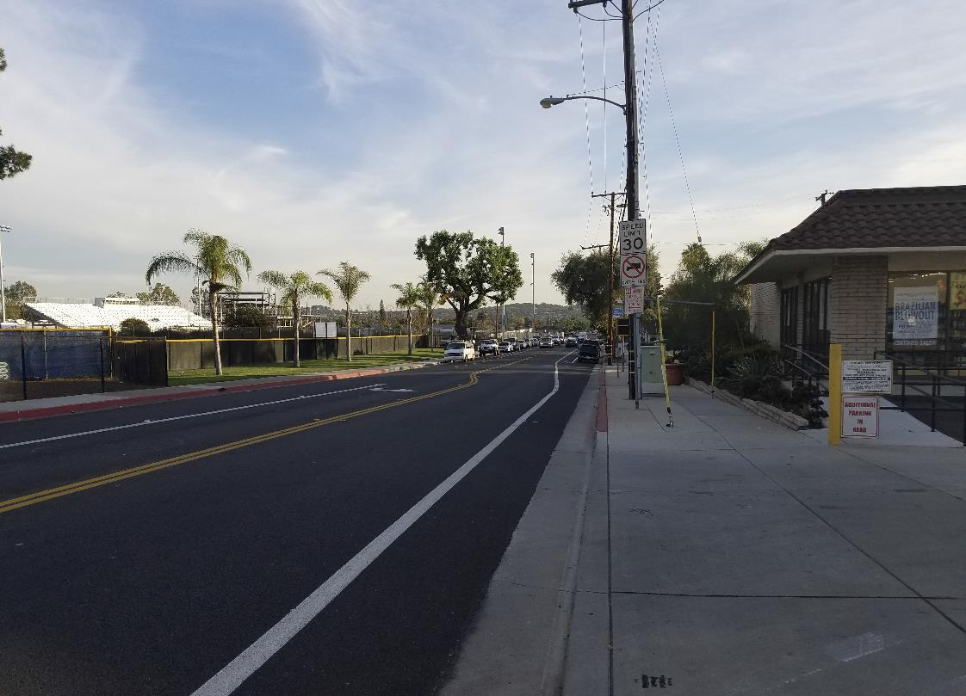
Idaho Street (Repave)
Completed in 2018
Added Class II Bike Lanes (~1 mi)
$800K
Reduced street crown from 12% to 7%
Replaced Water Main

Slide 25
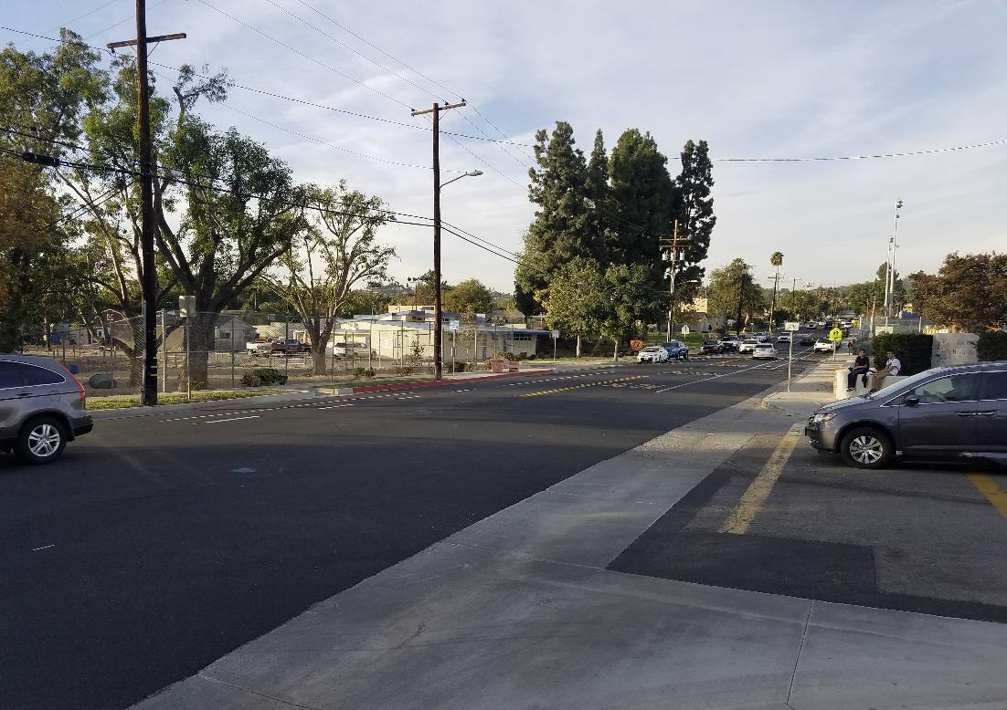
Idaho Street (Repave)
Completed in 2018
Added Class II Bike Lanes (~1 mi)
$800K
Reduced street crown from 12% to 7%
Replaced Water Main

Slide 26
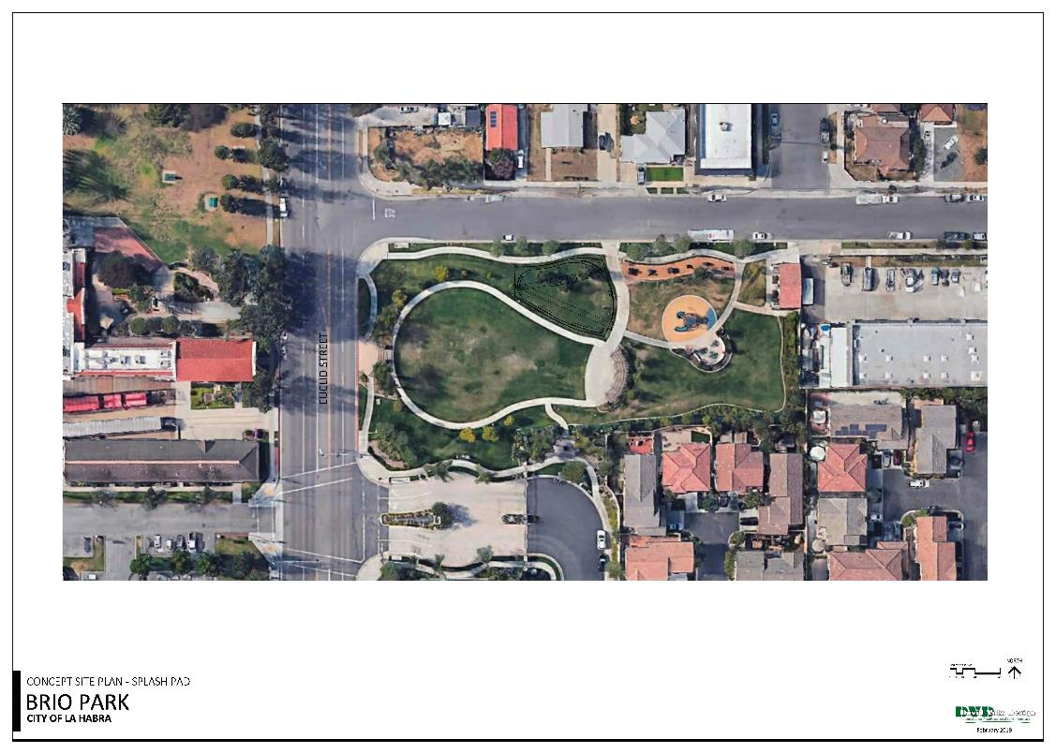
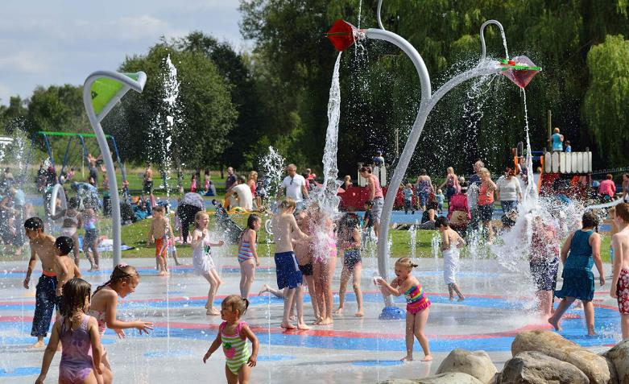
Splash Pads
Currently On-Going
$1.2 M Grant

Slide 27
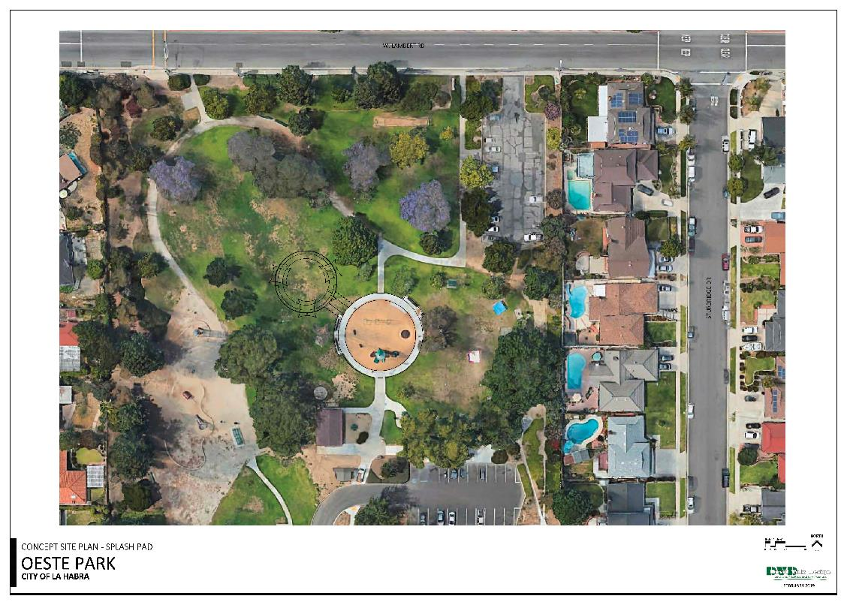
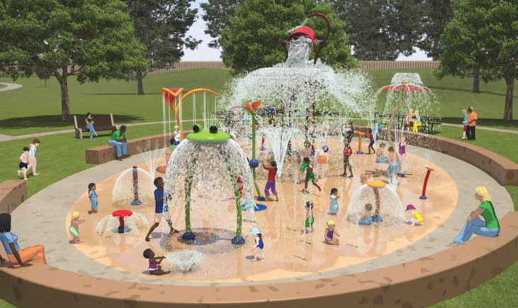
Splash Pads
Currently On-Going
$1.2 M Grant

Slide 28
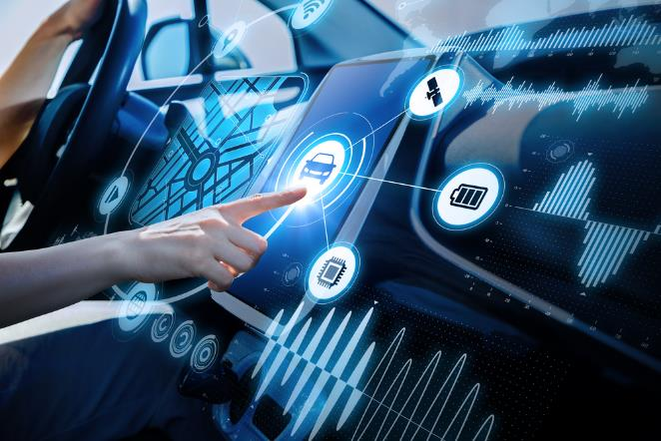
Future
Connected Vehicles/Autonomous Vehicles
Citywide Fiber Optic Communication Network
Uninterruptible Power Supply (UPS) Units
LED Safety Lighting
OC Loop Connection
Passenger Rail Service?

Slide 29
Thank You

Slide 30
Michael Plotnik, TE
Traffic Manager
mplotnik@lahabraca.gov
(562) 383-4162

